Slide 1
Red Black TREE

Slide 2
Balanced Binary Tree
The disadvantage of a binary search tree is that its height can be as large as N-1
This means that the time needed to perform insertion and deletion and many other operations can be O(N) in the worst case
We want a tree with small height
A binary tree with N node has height at least
θ(log N)
Thus, our goal is to keep the height of a binary search tree O(log N)
Such trees are called balanced binary search trees.
Examples are AVL tree, red-black tree.

Slide 3
Red Black Tree
Red-Black tree is a binary search tree in which every node is colored with either red or black. It is a type of self balancing binary search tree. It has a good efficient worst case running time complexity.

Slide 4
Properties of Red Black Tree:
The Red-Black tree satisfies all the properties of binary search tree in addition to that it satisfies following additional properties –
1. Root property: The root is black.
2. External property: Every leaf (Leaf is a NULL child of a node) is black in Red-Black tree.
3. Internal property: The children of a red node are black. Hence, possible parent of red node is a black node.
4. Depth property: All the leaves have the same black depth.
5. Path property: Every simple path from root to descendant leaf node contains same number of black nodes.

Slide 5
The result of all these above-mentioned properties is that the Red-Black tree is roughly balanced.
Rules that every Red-Black Tree follows:
Every node has a color either red or black.
The root of the tree is always black.
There are no two adjacent red nodes (A red node cannot have a red parent or red child).
Every path from a node (including root) to any of its descendants NULL nodes has the same number of black nodes.
Every leaf (i.e., NULL node) must be colored BLACK.

Slide 6
Comparison with AVL Tree:
The AVL trees are more balanced compared to Red-Black Trees, but they may cause more rotations during insertion and deletion. So if your application involves frequent insertions and deletions, then Red-Black trees should be preferred. And if the insertions and deletions are less frequent and search is a more frequent operation, then AVL tree should be preferred over the Red-Black Tree.

Slide 7
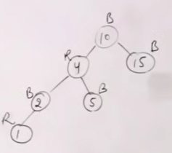
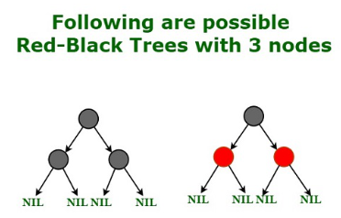
Examples of Red Black Trees

Slide 8
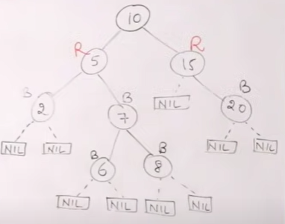
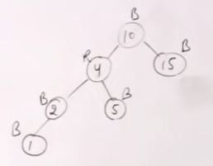
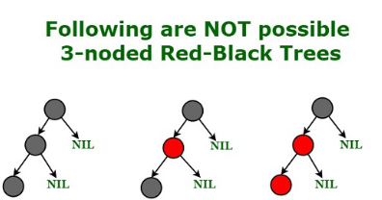
Examples of Non Red Black Trees

Slide 9
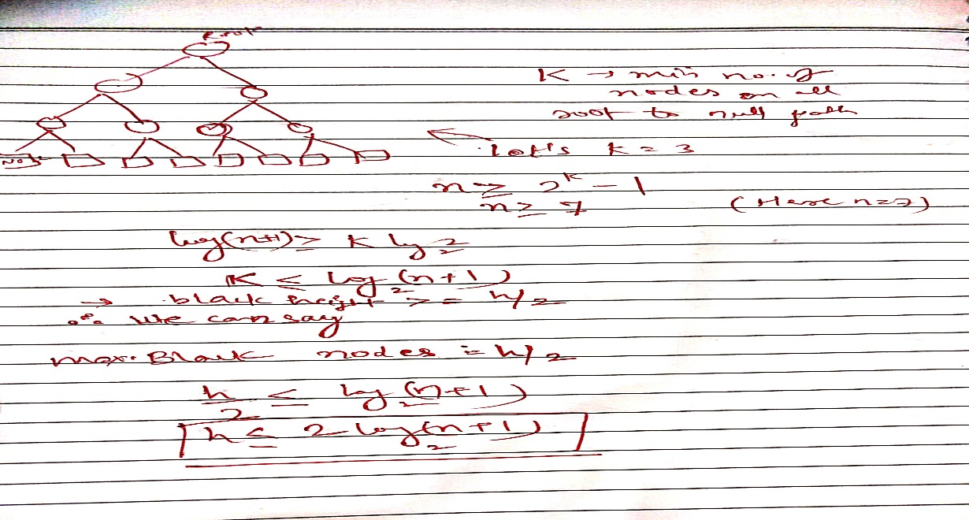
Points to remember
A Red-Black Tree of height h has black-height >= h/2.
Every Red Black Tree with n nodes has height <= 2Log₂(n+1)

Slide 10
Insertion in Red Black Tree
In the Red-Black tree, we use two tools to do the balancing.
Recoloring
Rotation

Slide 11
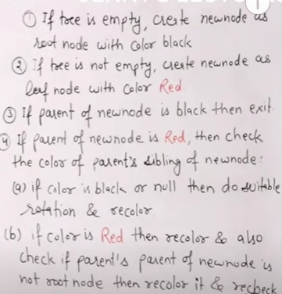
Insertion Algorithm
Notes:
4- a) single rotation : top two nodes recoloring, double rotation: first perform one rotation then consider top two for recoloring after second rotation.
4-b) recolor parent and sibling both

Slide 12
Examples
Refer shared pdf

Slide 13
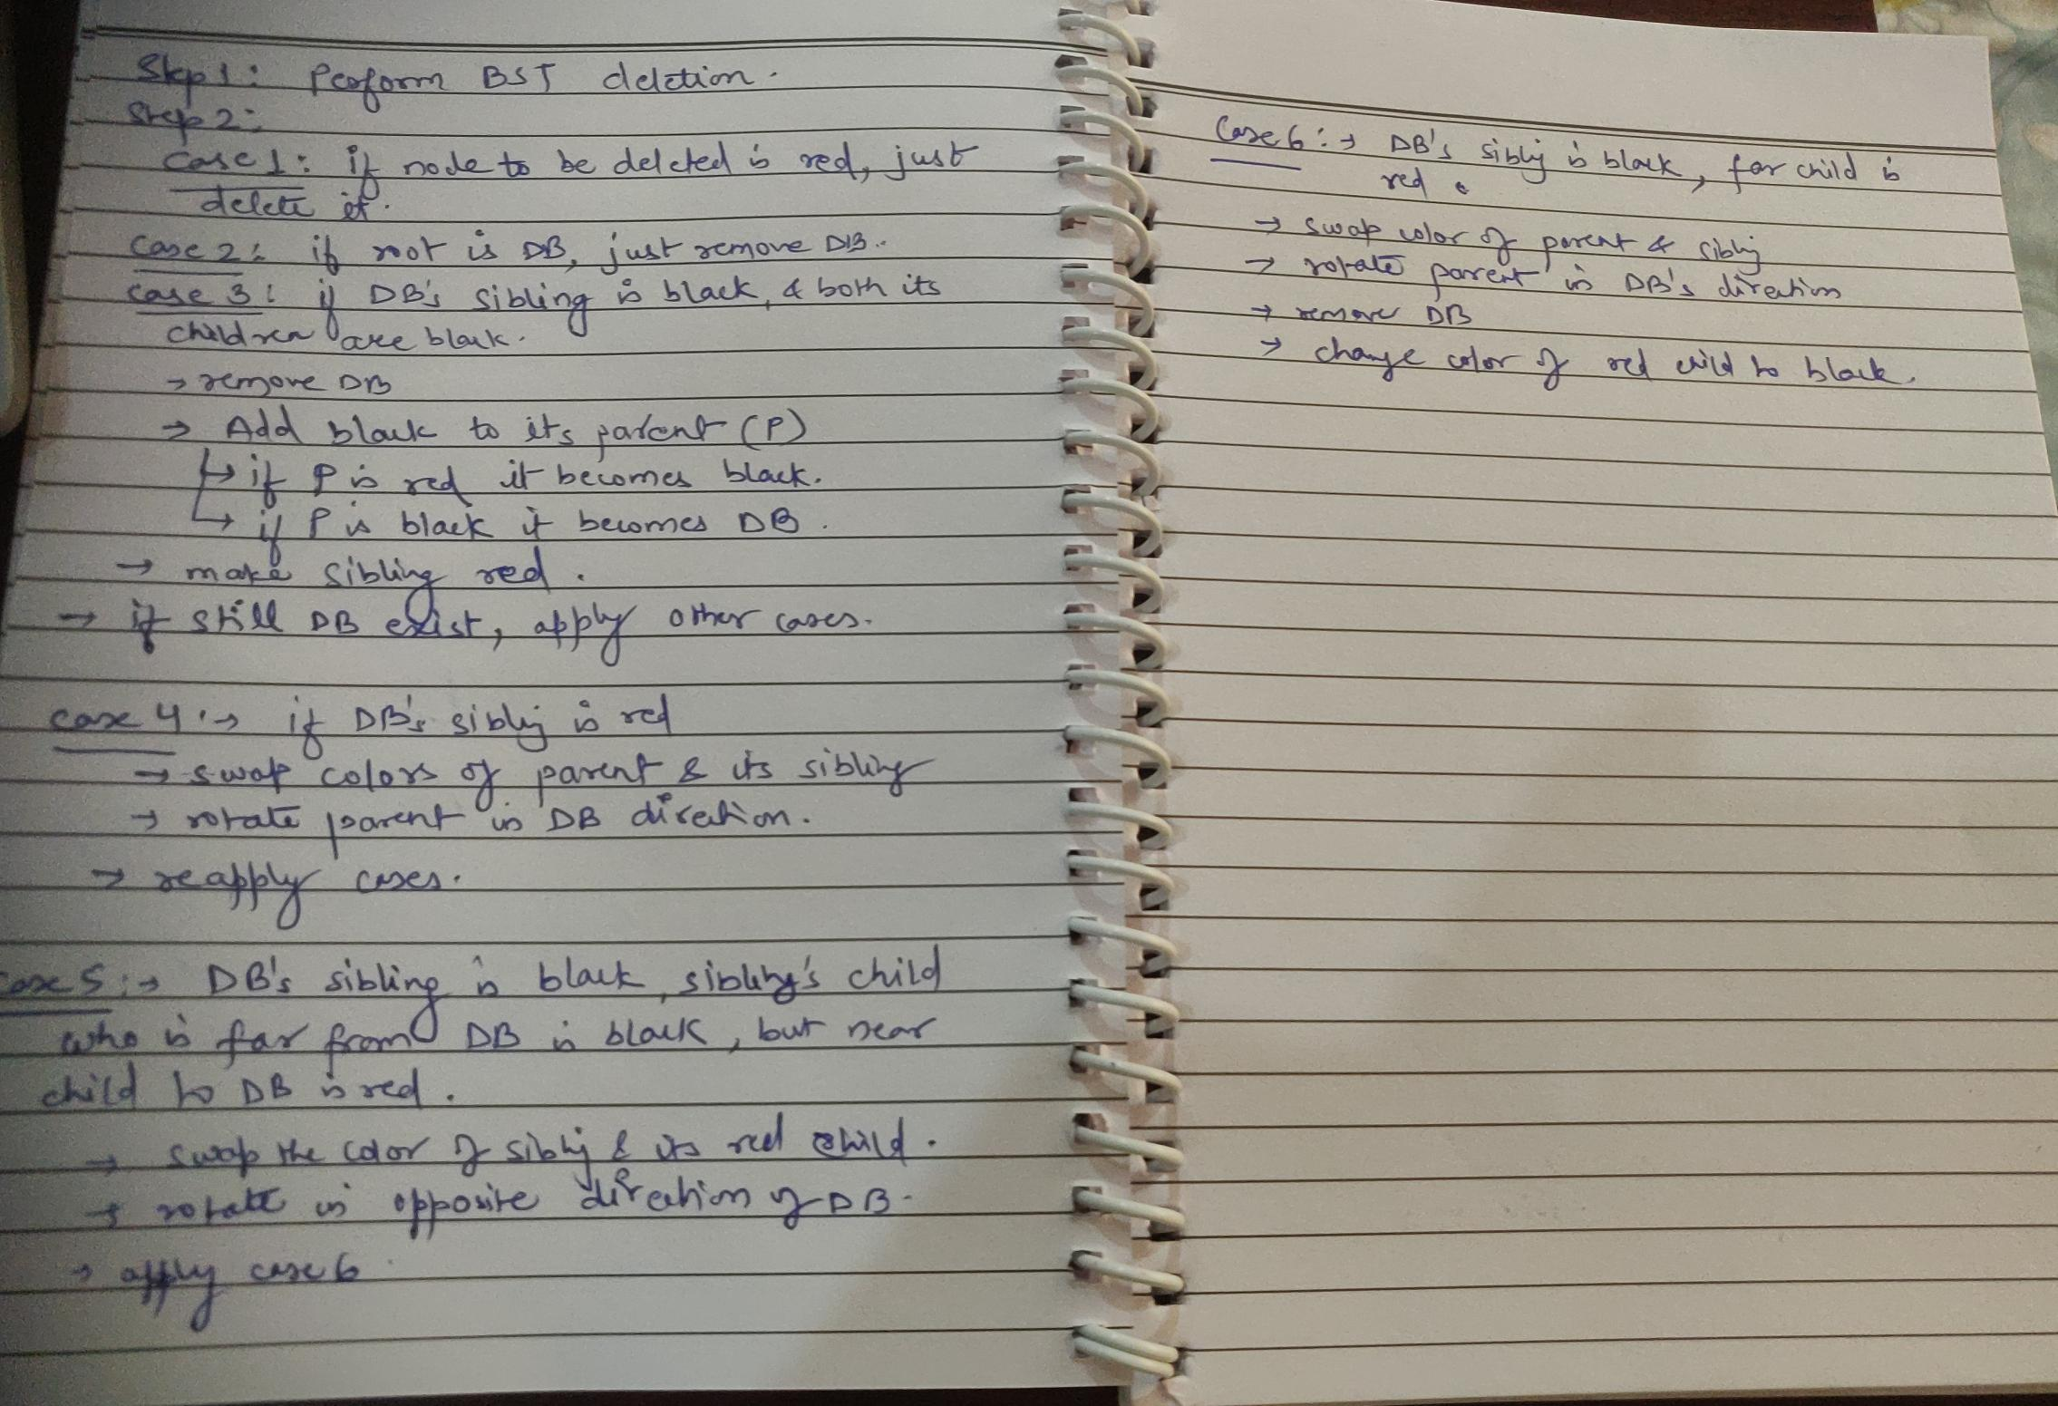
Deletion in RB tree

Slide 14
Examples
Refer shared pdf

